Slide 1


270
255
75

Slide 2
Looking for gap in 75-? mEv energy range

Slide 3
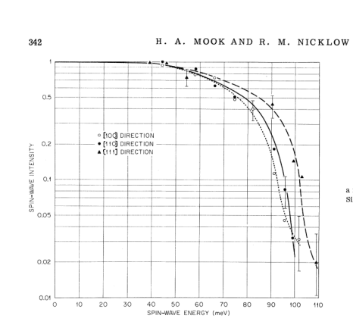
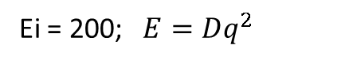
Ei = 200; $E=Dq^{2}$
Bragg 110, Directions [100] (ΓH), dE=2.5, dK=0.1
|D|=198 [meV*Α⁻²]
Bragg 1(-1)0, Directions [100] (ΓH), dE=2.5, dK=0.1
|D|=207 [meV*Α⁻²]
Bragg 200, Directions [100] (ΓH), dE=5, dK=0.1
|D|=230 [meV*Α⁻²]
dE=70-75, <±1,x,y> dK=0.2
dE=100-105, cut <0,x,y> dK=0.2
Gap

Slide 4
Adsorption?

Slide 5
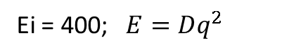
Ei=186 Bragg 200, Directions [100] (ΓH), dE=5, dK=0.1
|D|=237 [meV*Α⁻²]
Ei = 400; $E=Dq^{2}$
Bragg 110, Directions [100] (ΓH), dE=5, dK=0.1
|D|=237 [meV*Α⁻²]
Bragg 200, Directions [100] (ΓH), dE=5, dK=0.1
|D|=230 [meV*Α⁻²]
SW intersection observed at dE~250 in direction 200->3(-1)0?
Gap?

Slide 6
Searching for sw “Roof” at point “N” (1/2,1/2,0) at 250 mEV

Slide 7
Catching N point (½, ½,0)
Ei=401
Ei=787
dE=200+20
dE=200+20
Ei=787
dE=220+20
dE=220+20
dE=220+20
dE=240+20
dE=240+20
dE=240+20
Π?
dE=260+20
dE=260+20
dE=260+20
dE=360+20
dE=280+20
dE=280+20
Ei=787
dE=300+20
dE=320+20
dE=340+20
Removed background

